Slide 1
Function mb() 的参数变化带来的 images

Slide 2
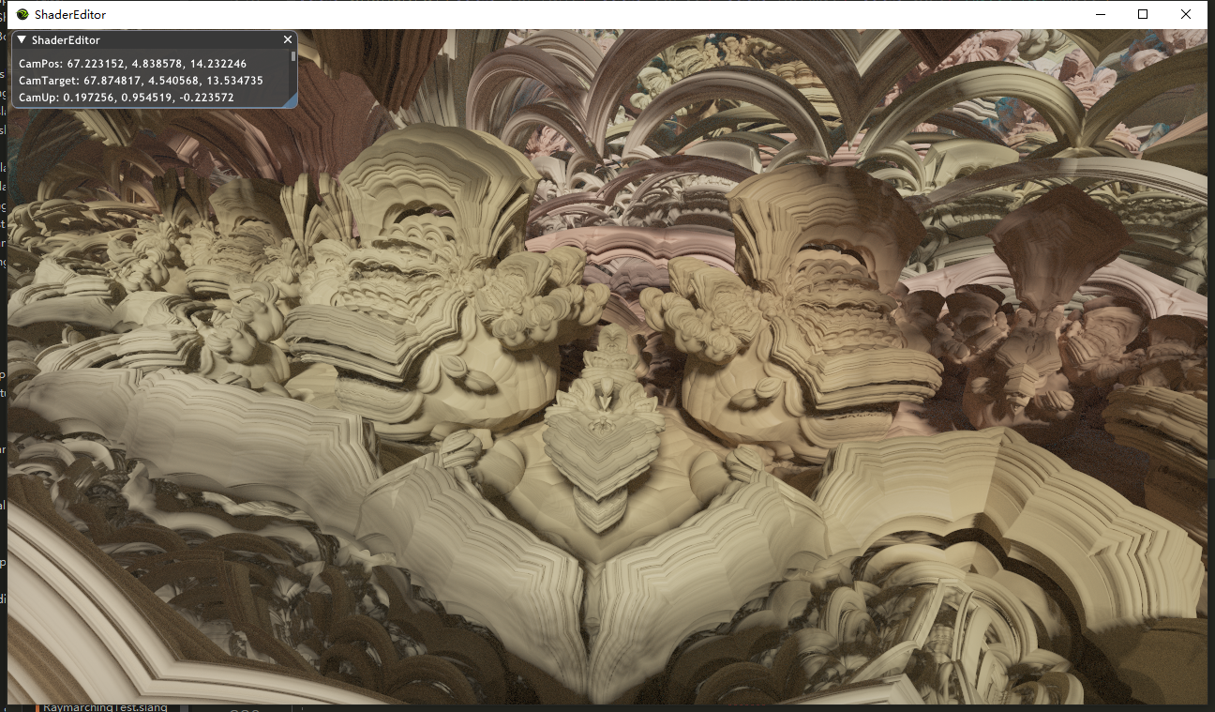
z.y = mod(z.x + 1.0, 2.0) - 1.0; rot xz

Slide 3
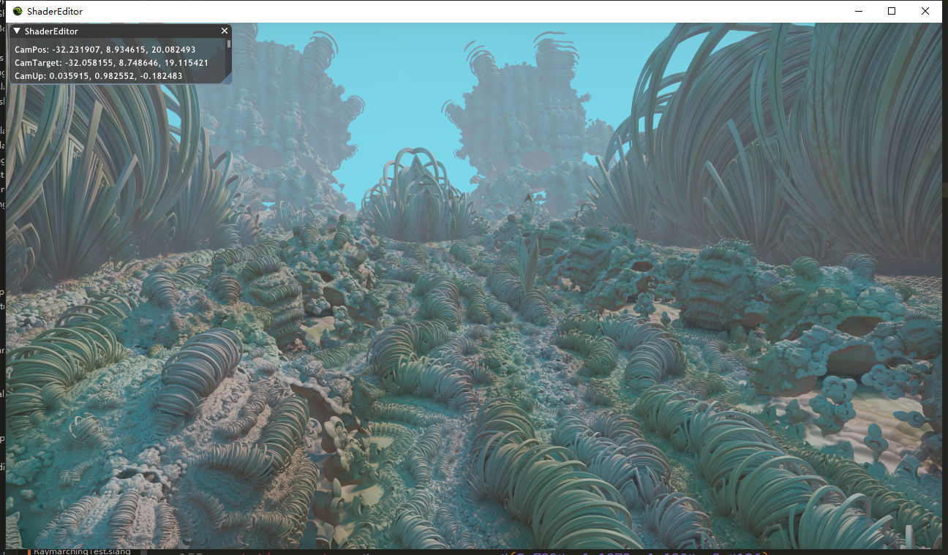
z.x = mod(z.y + 1.0, 2.0) - 1.0; rot xy

Slide 4
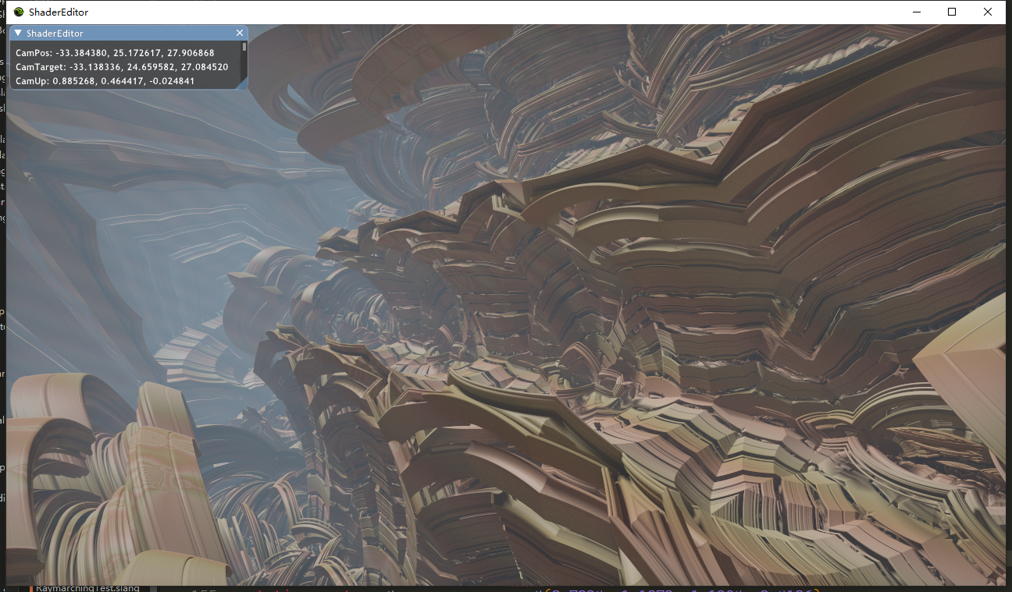
z.y = mod(z.z + 1.0, 2.0) - 1.0; z.xy = mul(rot, z.xy);

Slide 5
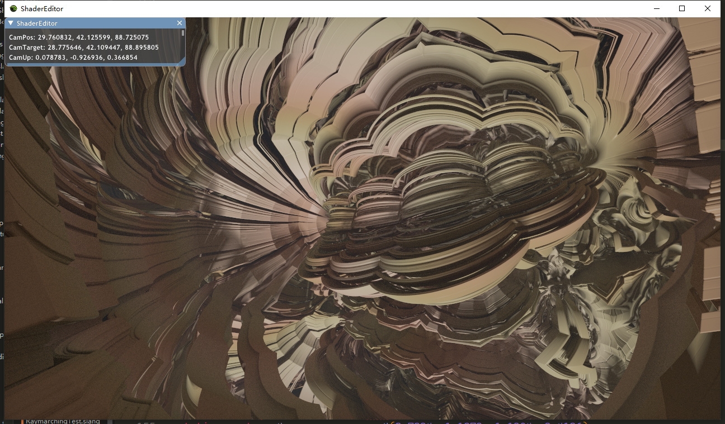
z.y = mod(z.z + 1.0, 2.0) - 1.0; rot xy

Slide 6
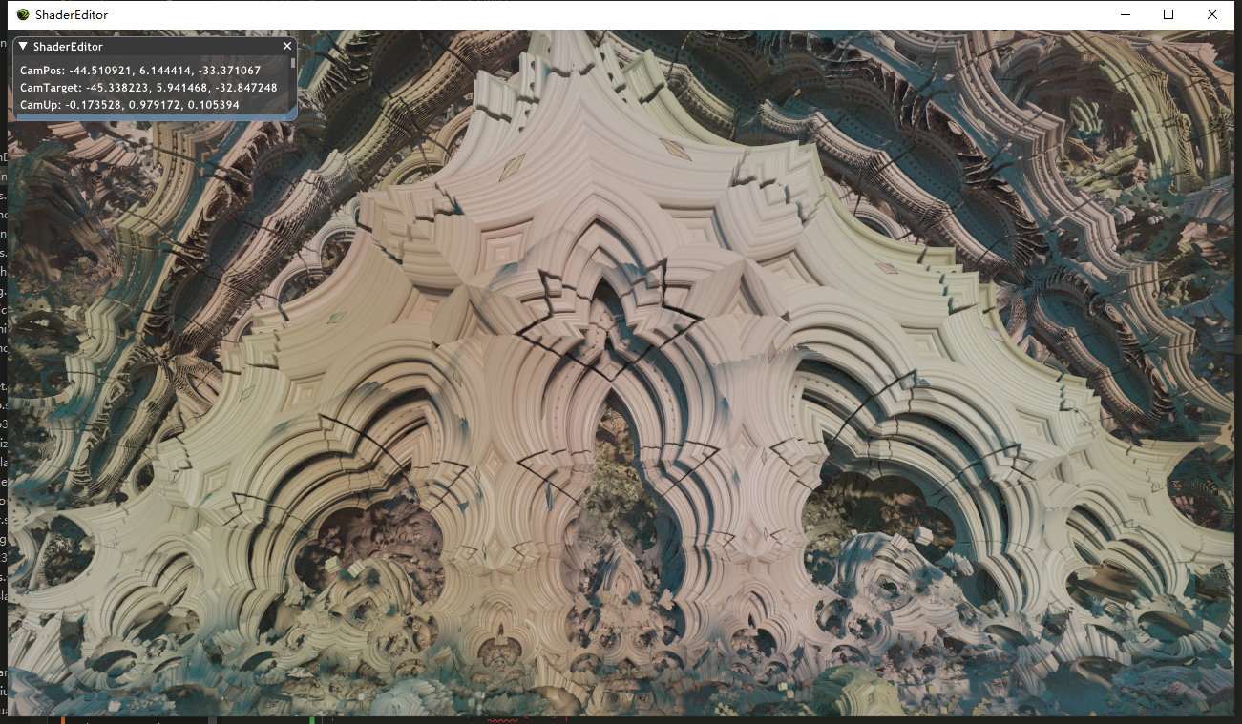
z mod z rot xz

Slide 7
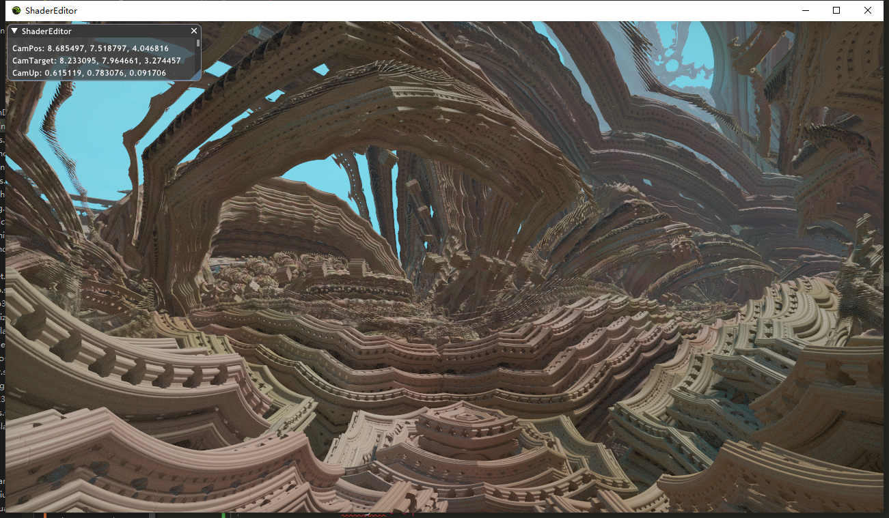
z.z = mod(z.z + 1.0, 2.0) - 1.0; rot xz

Slide 8
